Slide 1
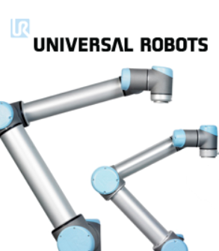
Vision Datalogic Communications UR Robots

Slide 2
OVERVIEW
Sequence of events
1-Robot Sends “cmd trigger” through TCP/IP to vision system
2-Vision System runs program and sends out X,Y, Theta positions as string to robot.
NOTE: UR requires ( ) ie. (45.3,-98,270) Denso requires no ( ). Both require
coma delimited data and Carriage Return, Line Feed.
3-Robot receives data and moves to position.
Setup Steps
1-VISION: Create five dot target to fill FOV. Must have black dots only on white background.
Only white background with medium size black dots. This is for the calibration routine on
the camera side.
2-VISION: CLICK--Create points within the calibration tab
3-Robot: Move Robot end-of-arm to exact center of the dots and enter X,Y data in
corresponding calibration fields.
4-VISION: Click Calibrate and note quality of calibration.

Slide 3
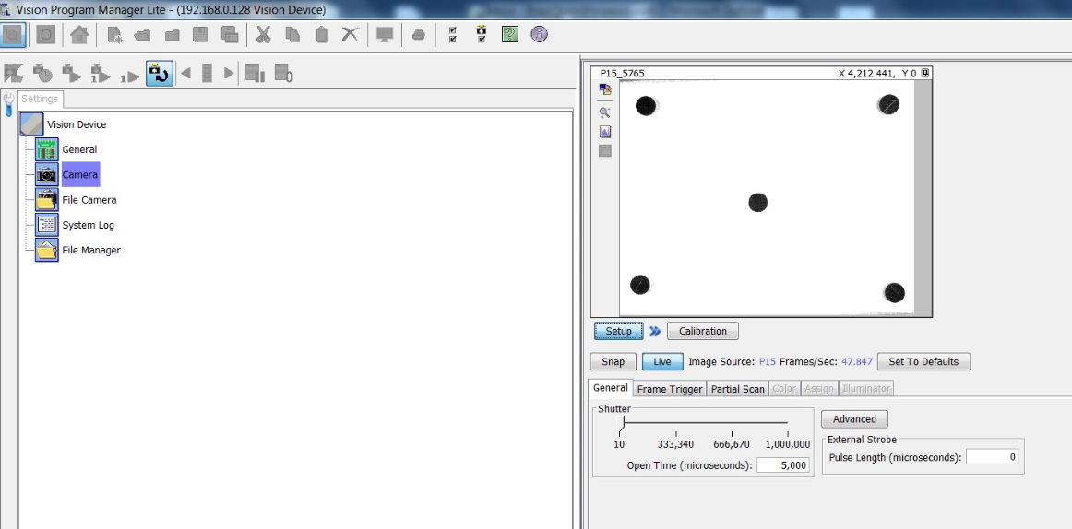
General Overview Vision
1-Place camera on
live mode and adjust
camera as per image.
2-Adjust lens and
shutter speed.
3-IMPORTANT:
No other markings
in image. Only dots
and white.
DATALOGIC VISION SOFTWARE VERSION 11.8.1 OR GREATER

Slide 4
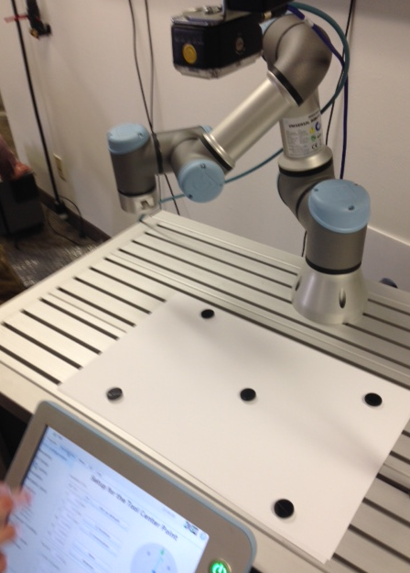
General Overview Vision

Slide 5
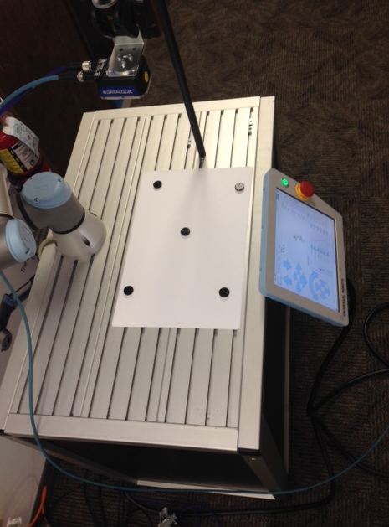
General Overview Vision

Slide 6
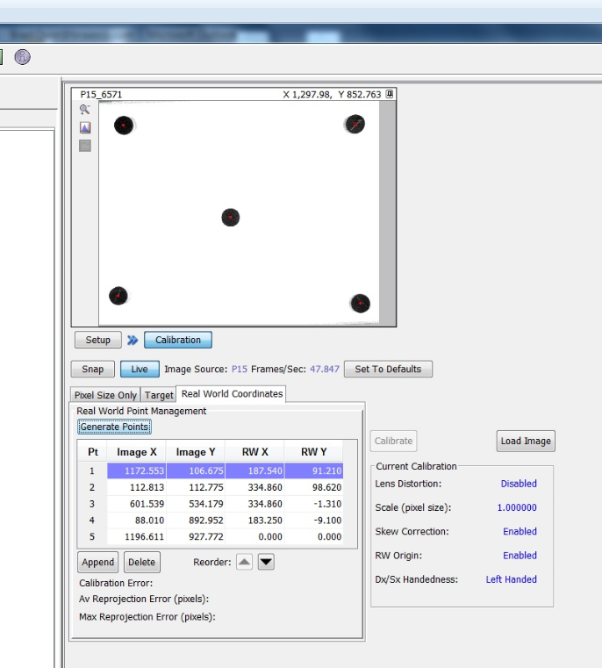
General Overview Vision
1-Go to Calibration field
Generate Points
2-Note the five small red dots
in the center of black dots and list of
Position points in list.
3-Re-order points that will correspond
to found robot points.

Slide 7
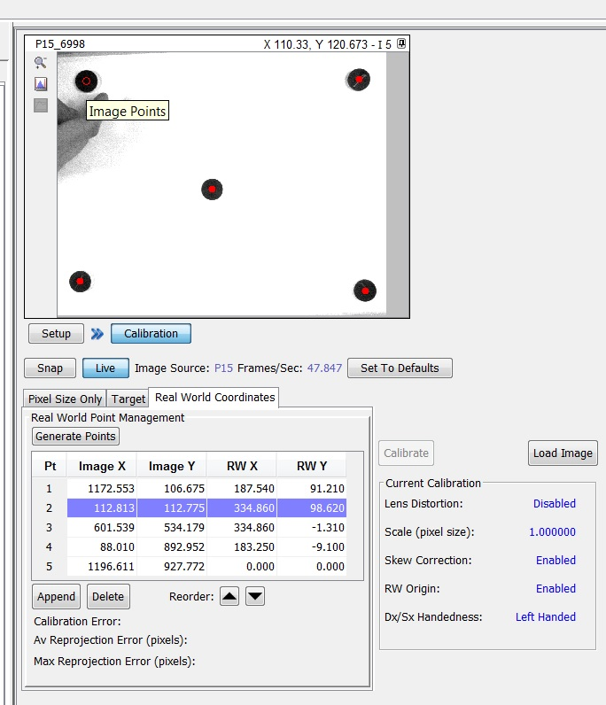
General Overview Vision
1-Click on small red dot and note which
point it corresponds to in the list.
2-Use reorder arrows to help correspont
dot positions to robot x,y positions
3-Make note which dots are 1-5.
It is highly recommend NOT to draw on
Dot target in case you need to re-calibrate.

Slide 8
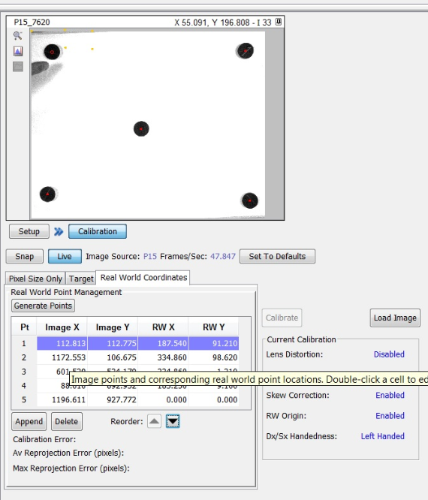
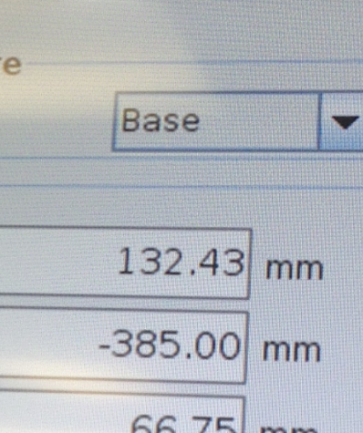
General Overview Robot
1-Move robot to each dot and enter BASE
Values into RW X and RW Y fields
2-Note: It is recommend to write down
Robot points for future reference.
A common mistake is to enter incorrect data.

Slide 9
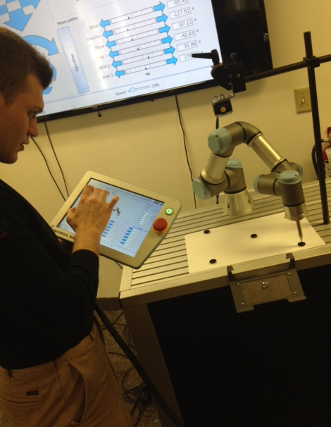
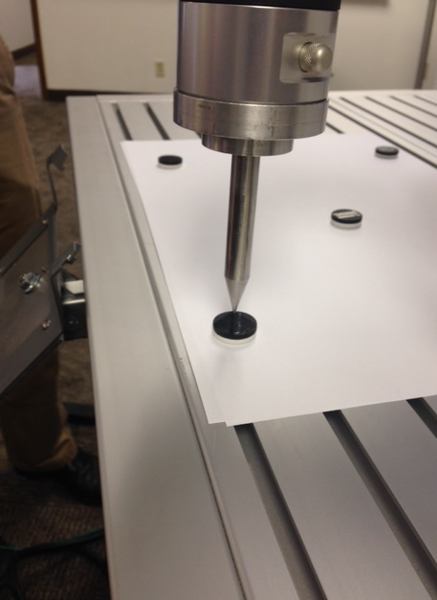
General Overview Vision

Slide 10
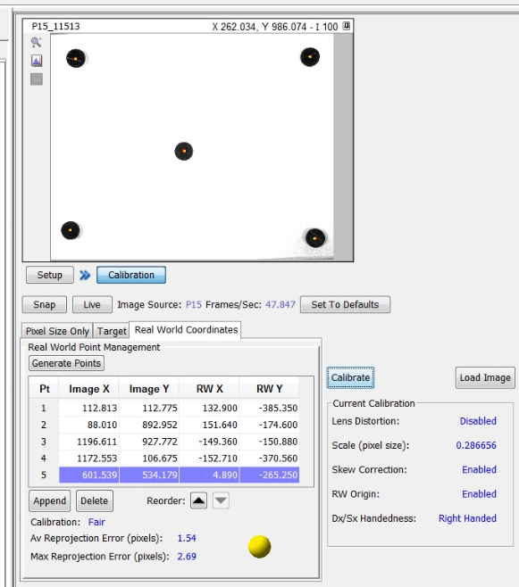
General Overview Vision
1-Click Calibrate
2-Note calibration score
3-Note small red and yellow dots on
Black dots on the calibration target.
This visually shows vision points and
Robot points. Red=Vision Yellow=robot
Repeat calibration if necessary.

Slide 11
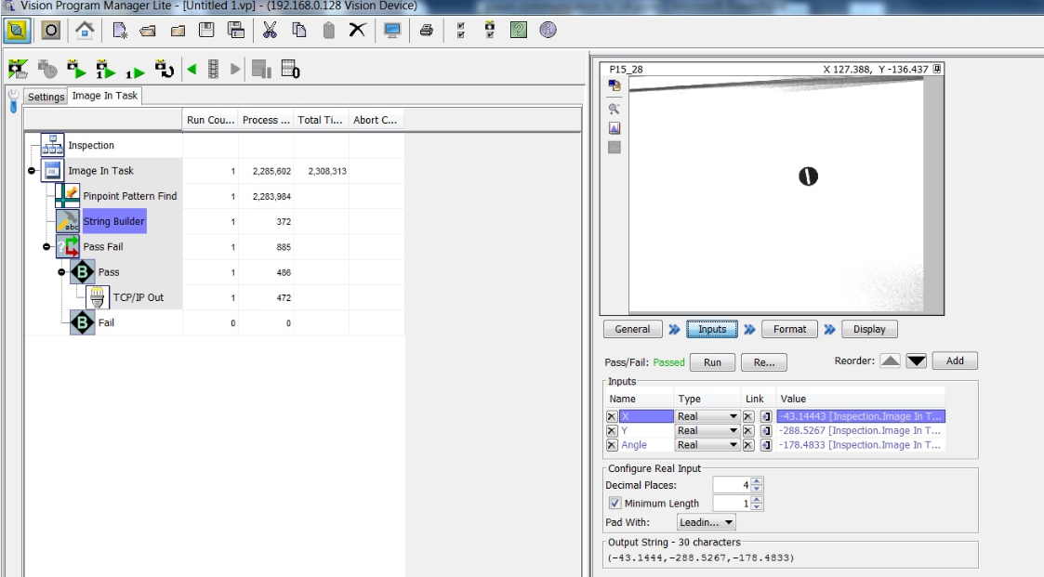
Program Vision
String Builder is used
to create X,Y,Theta data
to string for robot .
Be sure to have this format

Slide 12
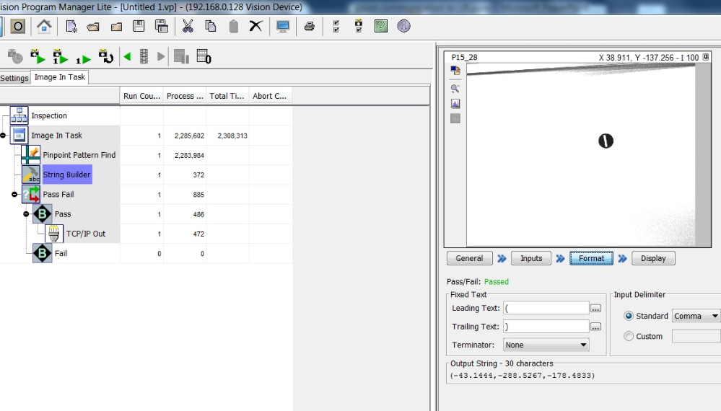
Program Vision
This is where you setup the leading and trailing text within the String Builder

Slide 13
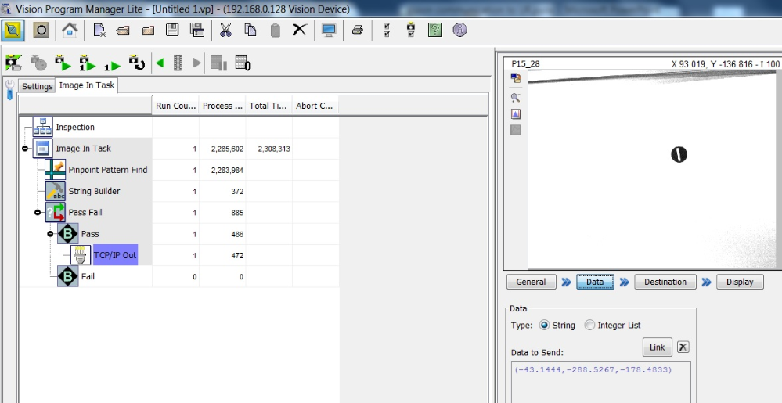
Program Vision
Link string data from string builder to TCP/IP tool

Slide 14
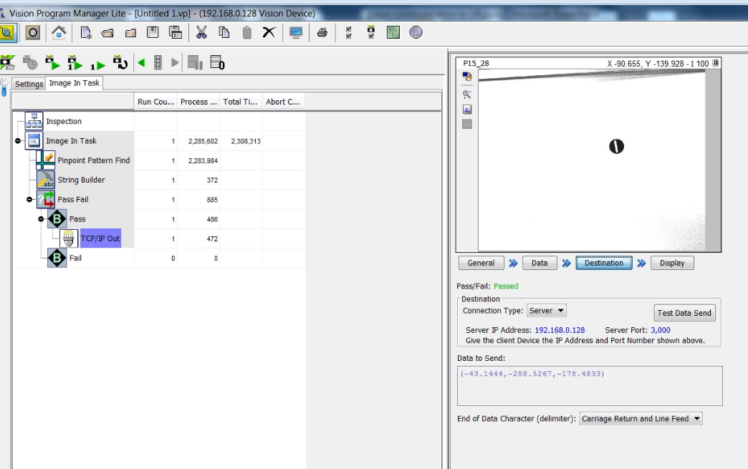
Program Vision
Setup TCP/IP Destination to this

Slide 15
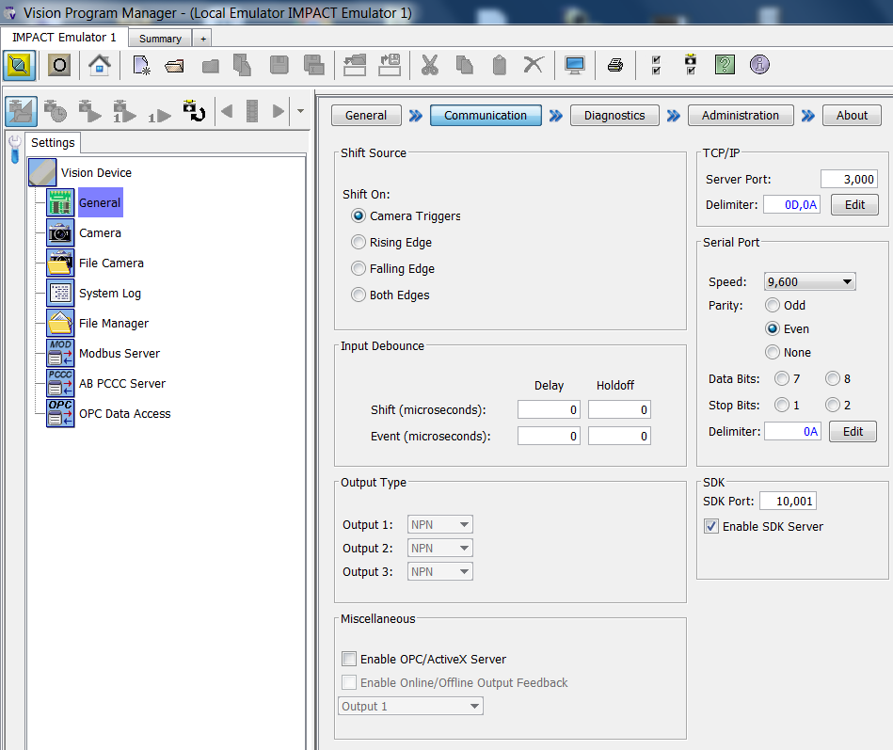
Program Vision
This is where to set TCP/IP port number and Carriage Return and Line Feed

Slide 16
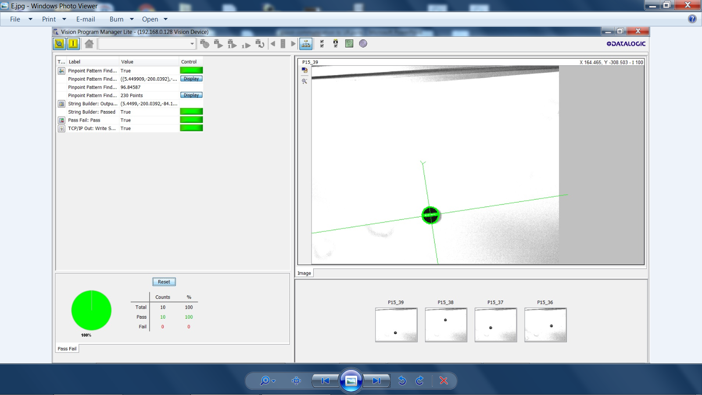
Program Vision

Slide 17
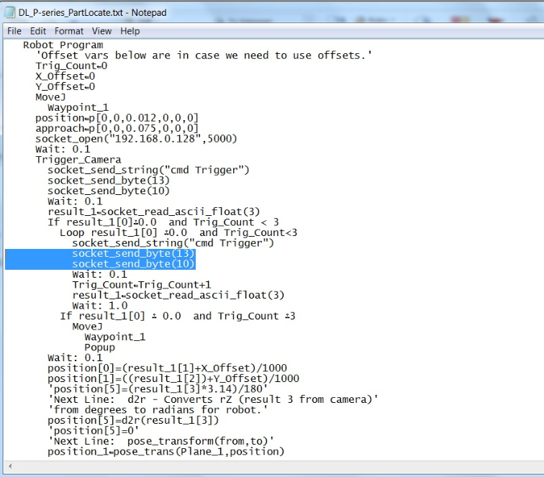
Program example Robot

